Slide 1
A Self-Tuning Fill Factor Technique for SQL Server
Mike Byrd
Senior Database Engineer
ByrdNest Consulting

Slide 2
Explore PASS

Slide 4




Mike Byrd
Rocket Scientist
USAF Fighter Pilot
Tech Writer for PC Magazine
Senior Database Engineer
ByrdNest Consulting
Mike-byrd
@ByrdNest_TX
Mike Byrd
CTO, insurance company
Part-time SQL Server consultant/trainer

Slide 5



I speak Texan; I hope y’all understand me!

Slide 6
Let’s let the cat out of the bag early!
Frankly speaking, this “experimental” method applied to a client’s OLTP production system produced an overall decrease in database wait times of 25-30%!
That is not a trivial improvement.
My goal is that this presentation will serve as an impetus for others to try this approach to improve the overall process!

Slide 7
Agenda
Fill Factor
What is it?
How is it used?
Approach to dynamic fill factor calculation
Short Review of Code (Highlights)
Analysis
Short-comings
Conclusions
No Demos ☹

Slide 8
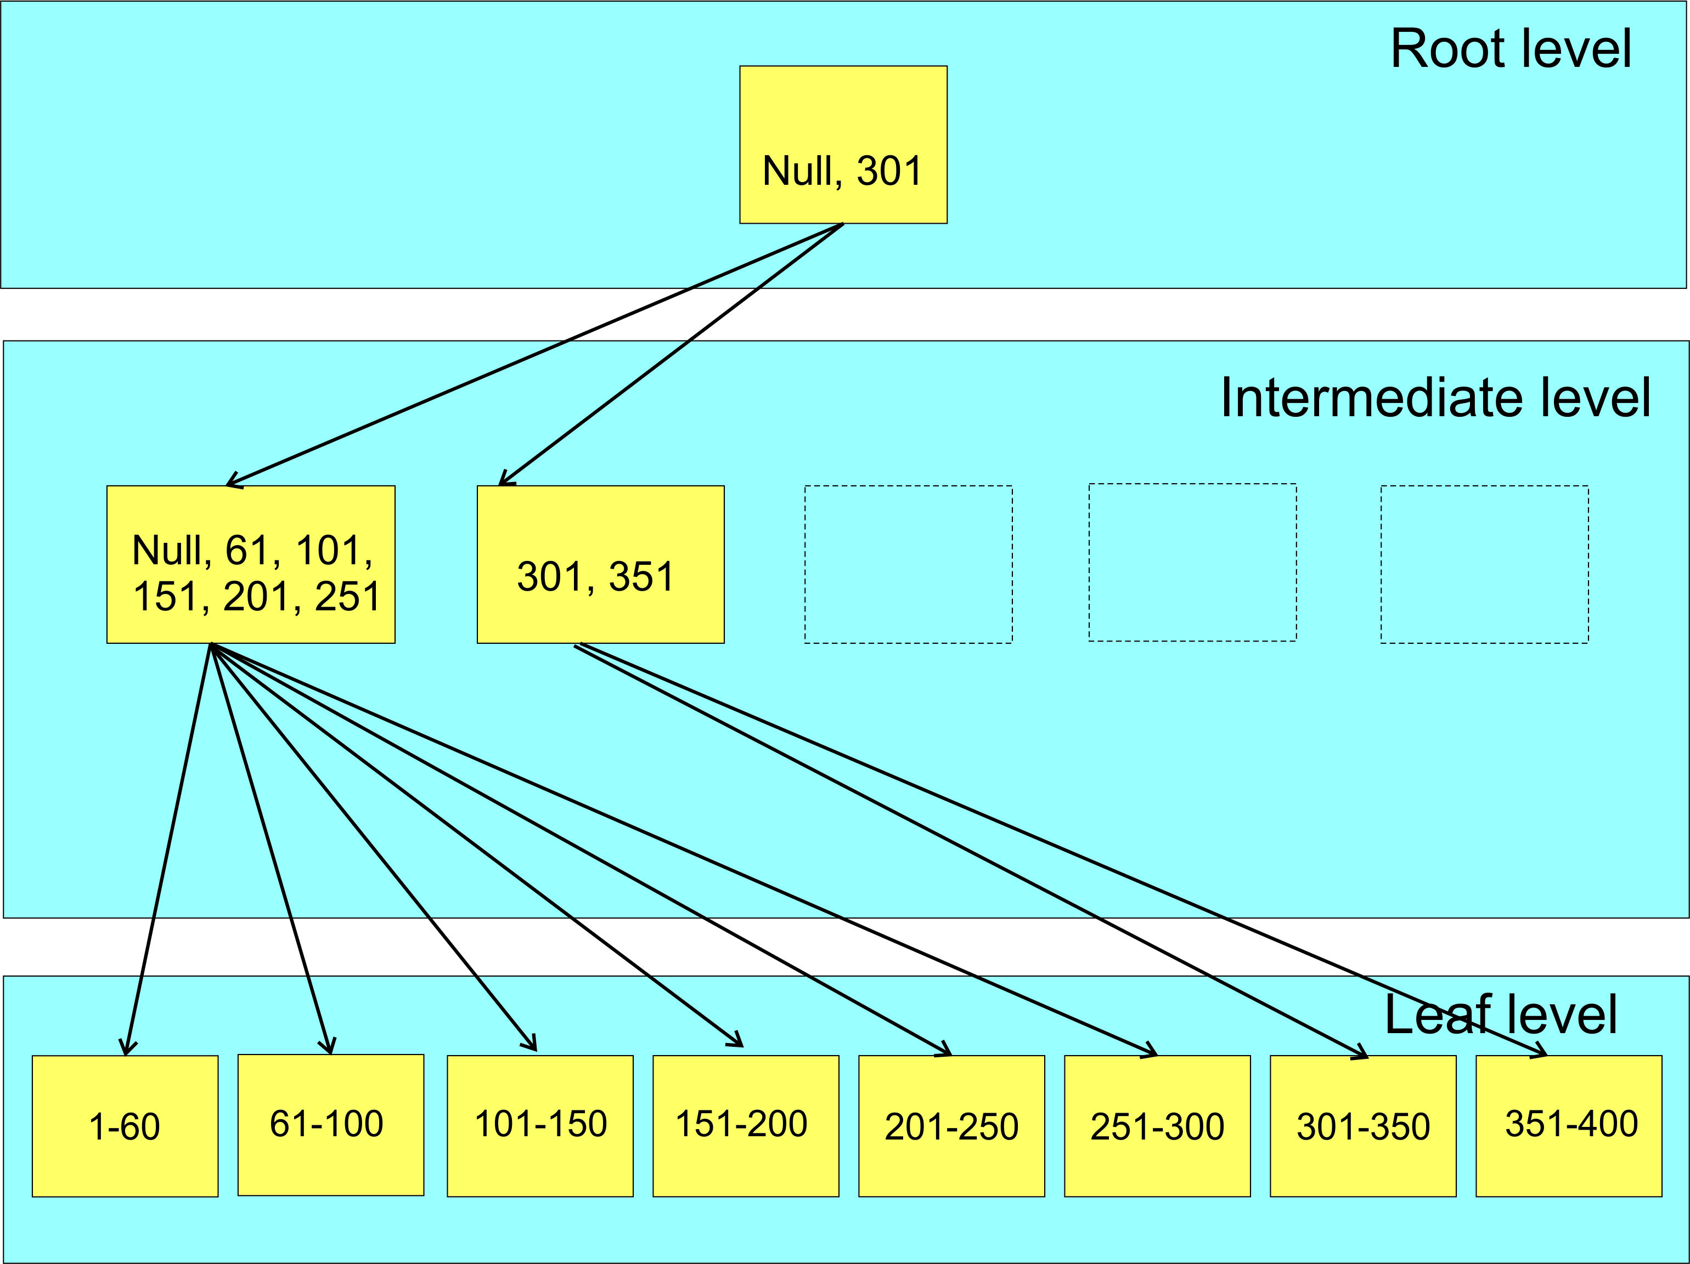
B-Tree Index
Left page boundary
Is always (NULL,
NULL, …)

Slide 9

Fill Factor
Percent of fullness of leaf level pages of an index
So what happens when a page cannot accommodate a new row?

Slide 10
SQL Server Fill Factor
When adding data (inserts or updates) you can get
Good Page Splits
Bad Page Splits
Case study presentation yesterday: 10 minute session on “How Bad Are Bad Page Splits?”
Average bad page split: cpu = 0.033ms, logical IOs = 9.2
Trick is to find a fill factor value that minimizes bad page splits, but doesn’t result in an excessive storage penalty.

Slide 11
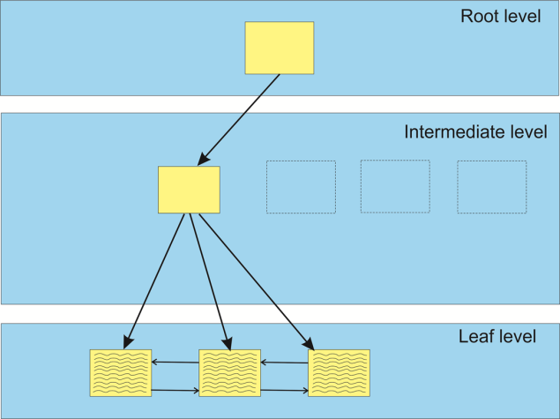
Page Splits
Data can be added row by row to a page until it is fulled (not enough space to contain another row in that page).
When not enough space within a page, a new page is added to the index.
Fill factor not an issue.
Only after a REBUILD
Well, Jeff Moden exception

Slide 12
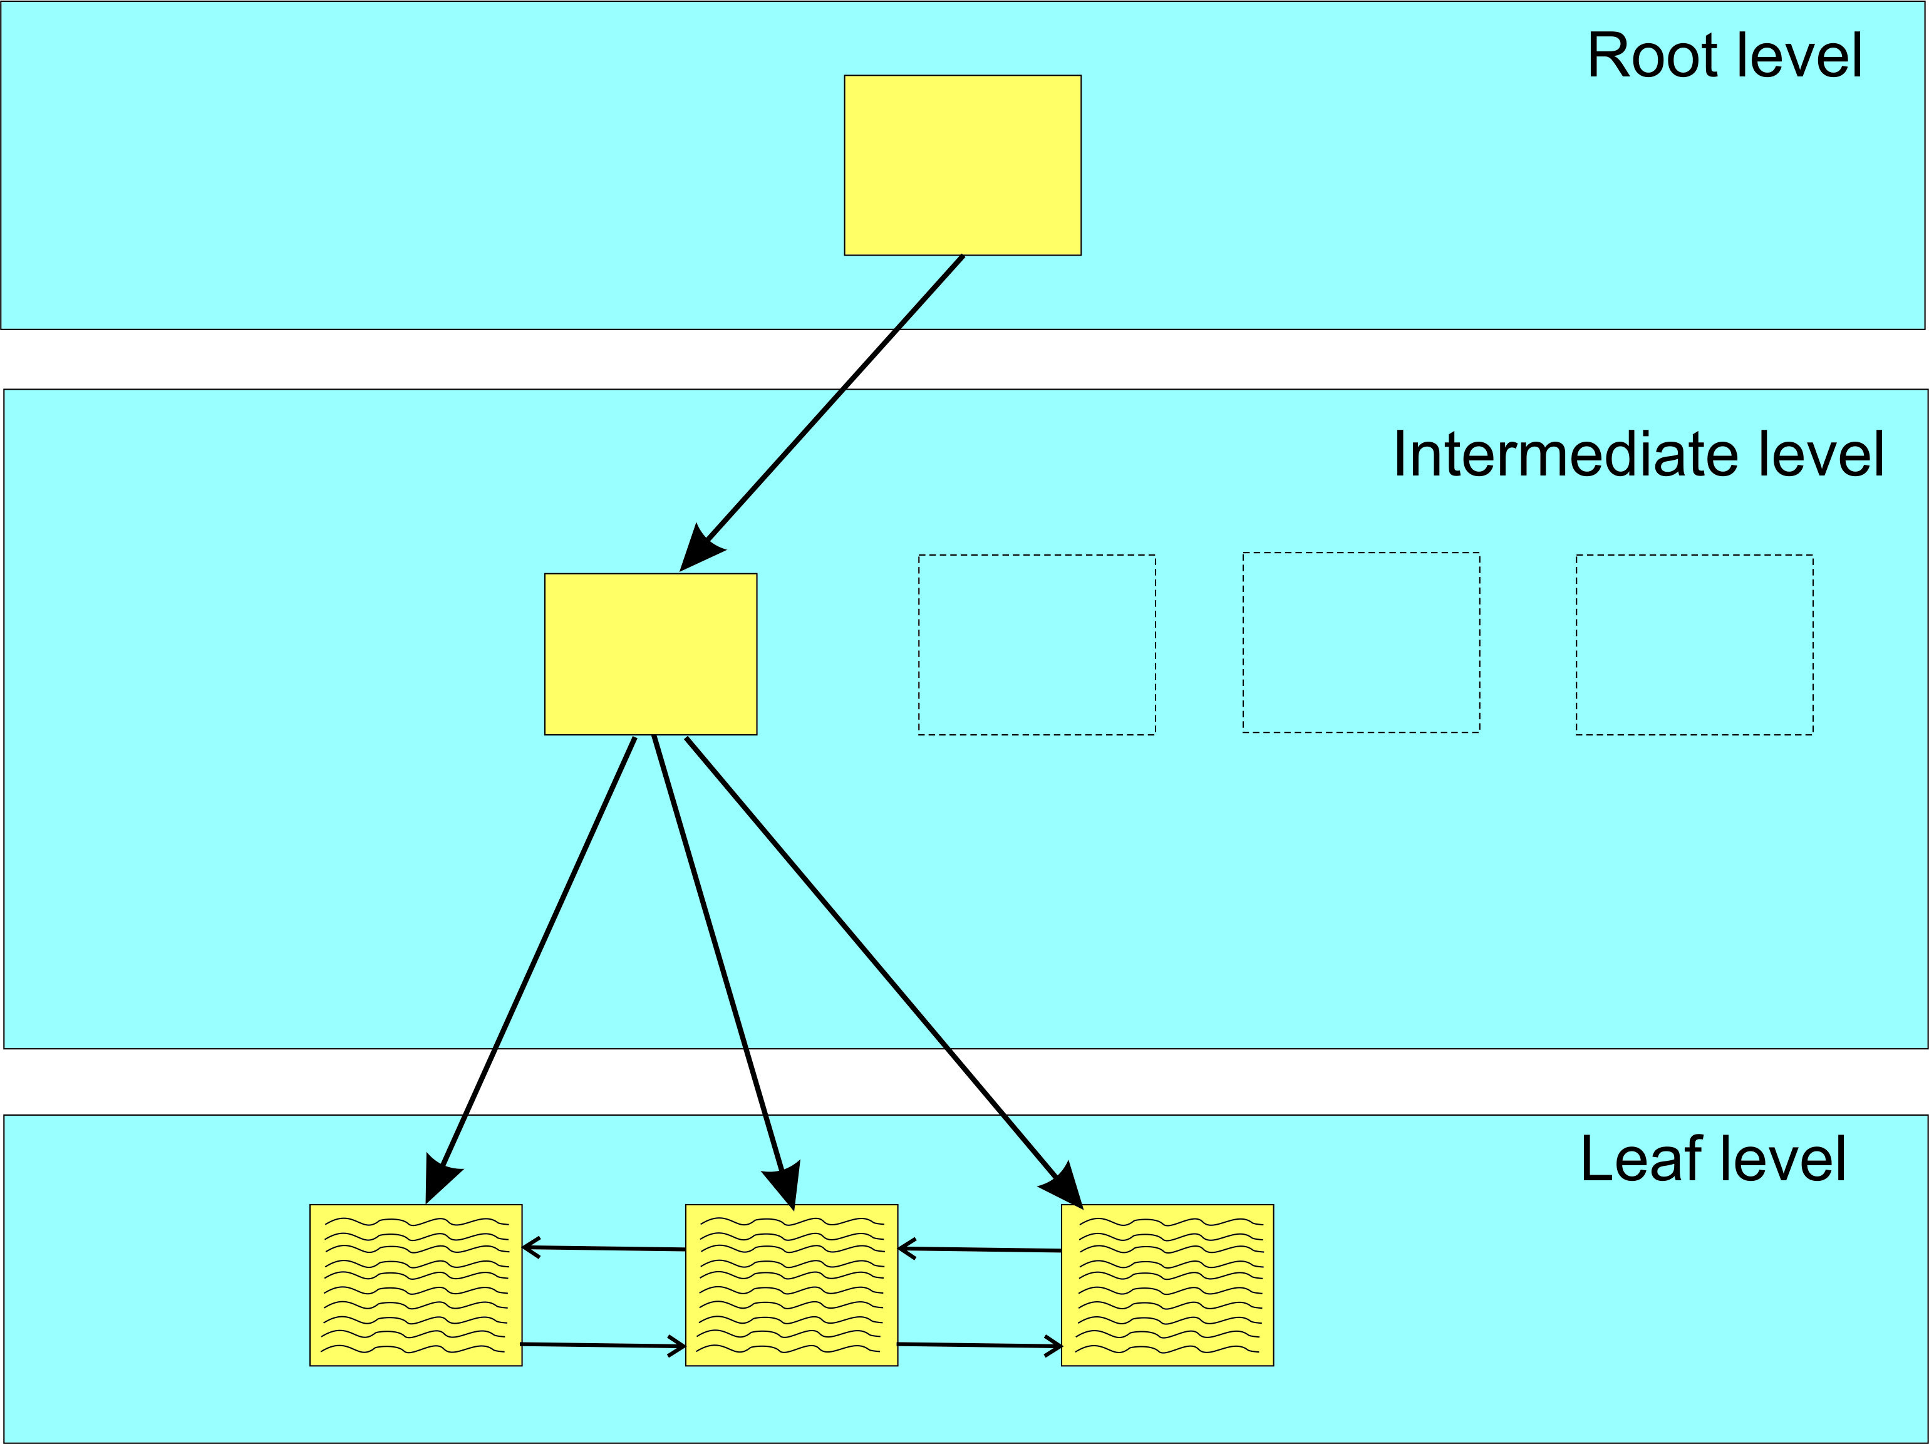
Partial view of B-Tree before adding row

Slide 13
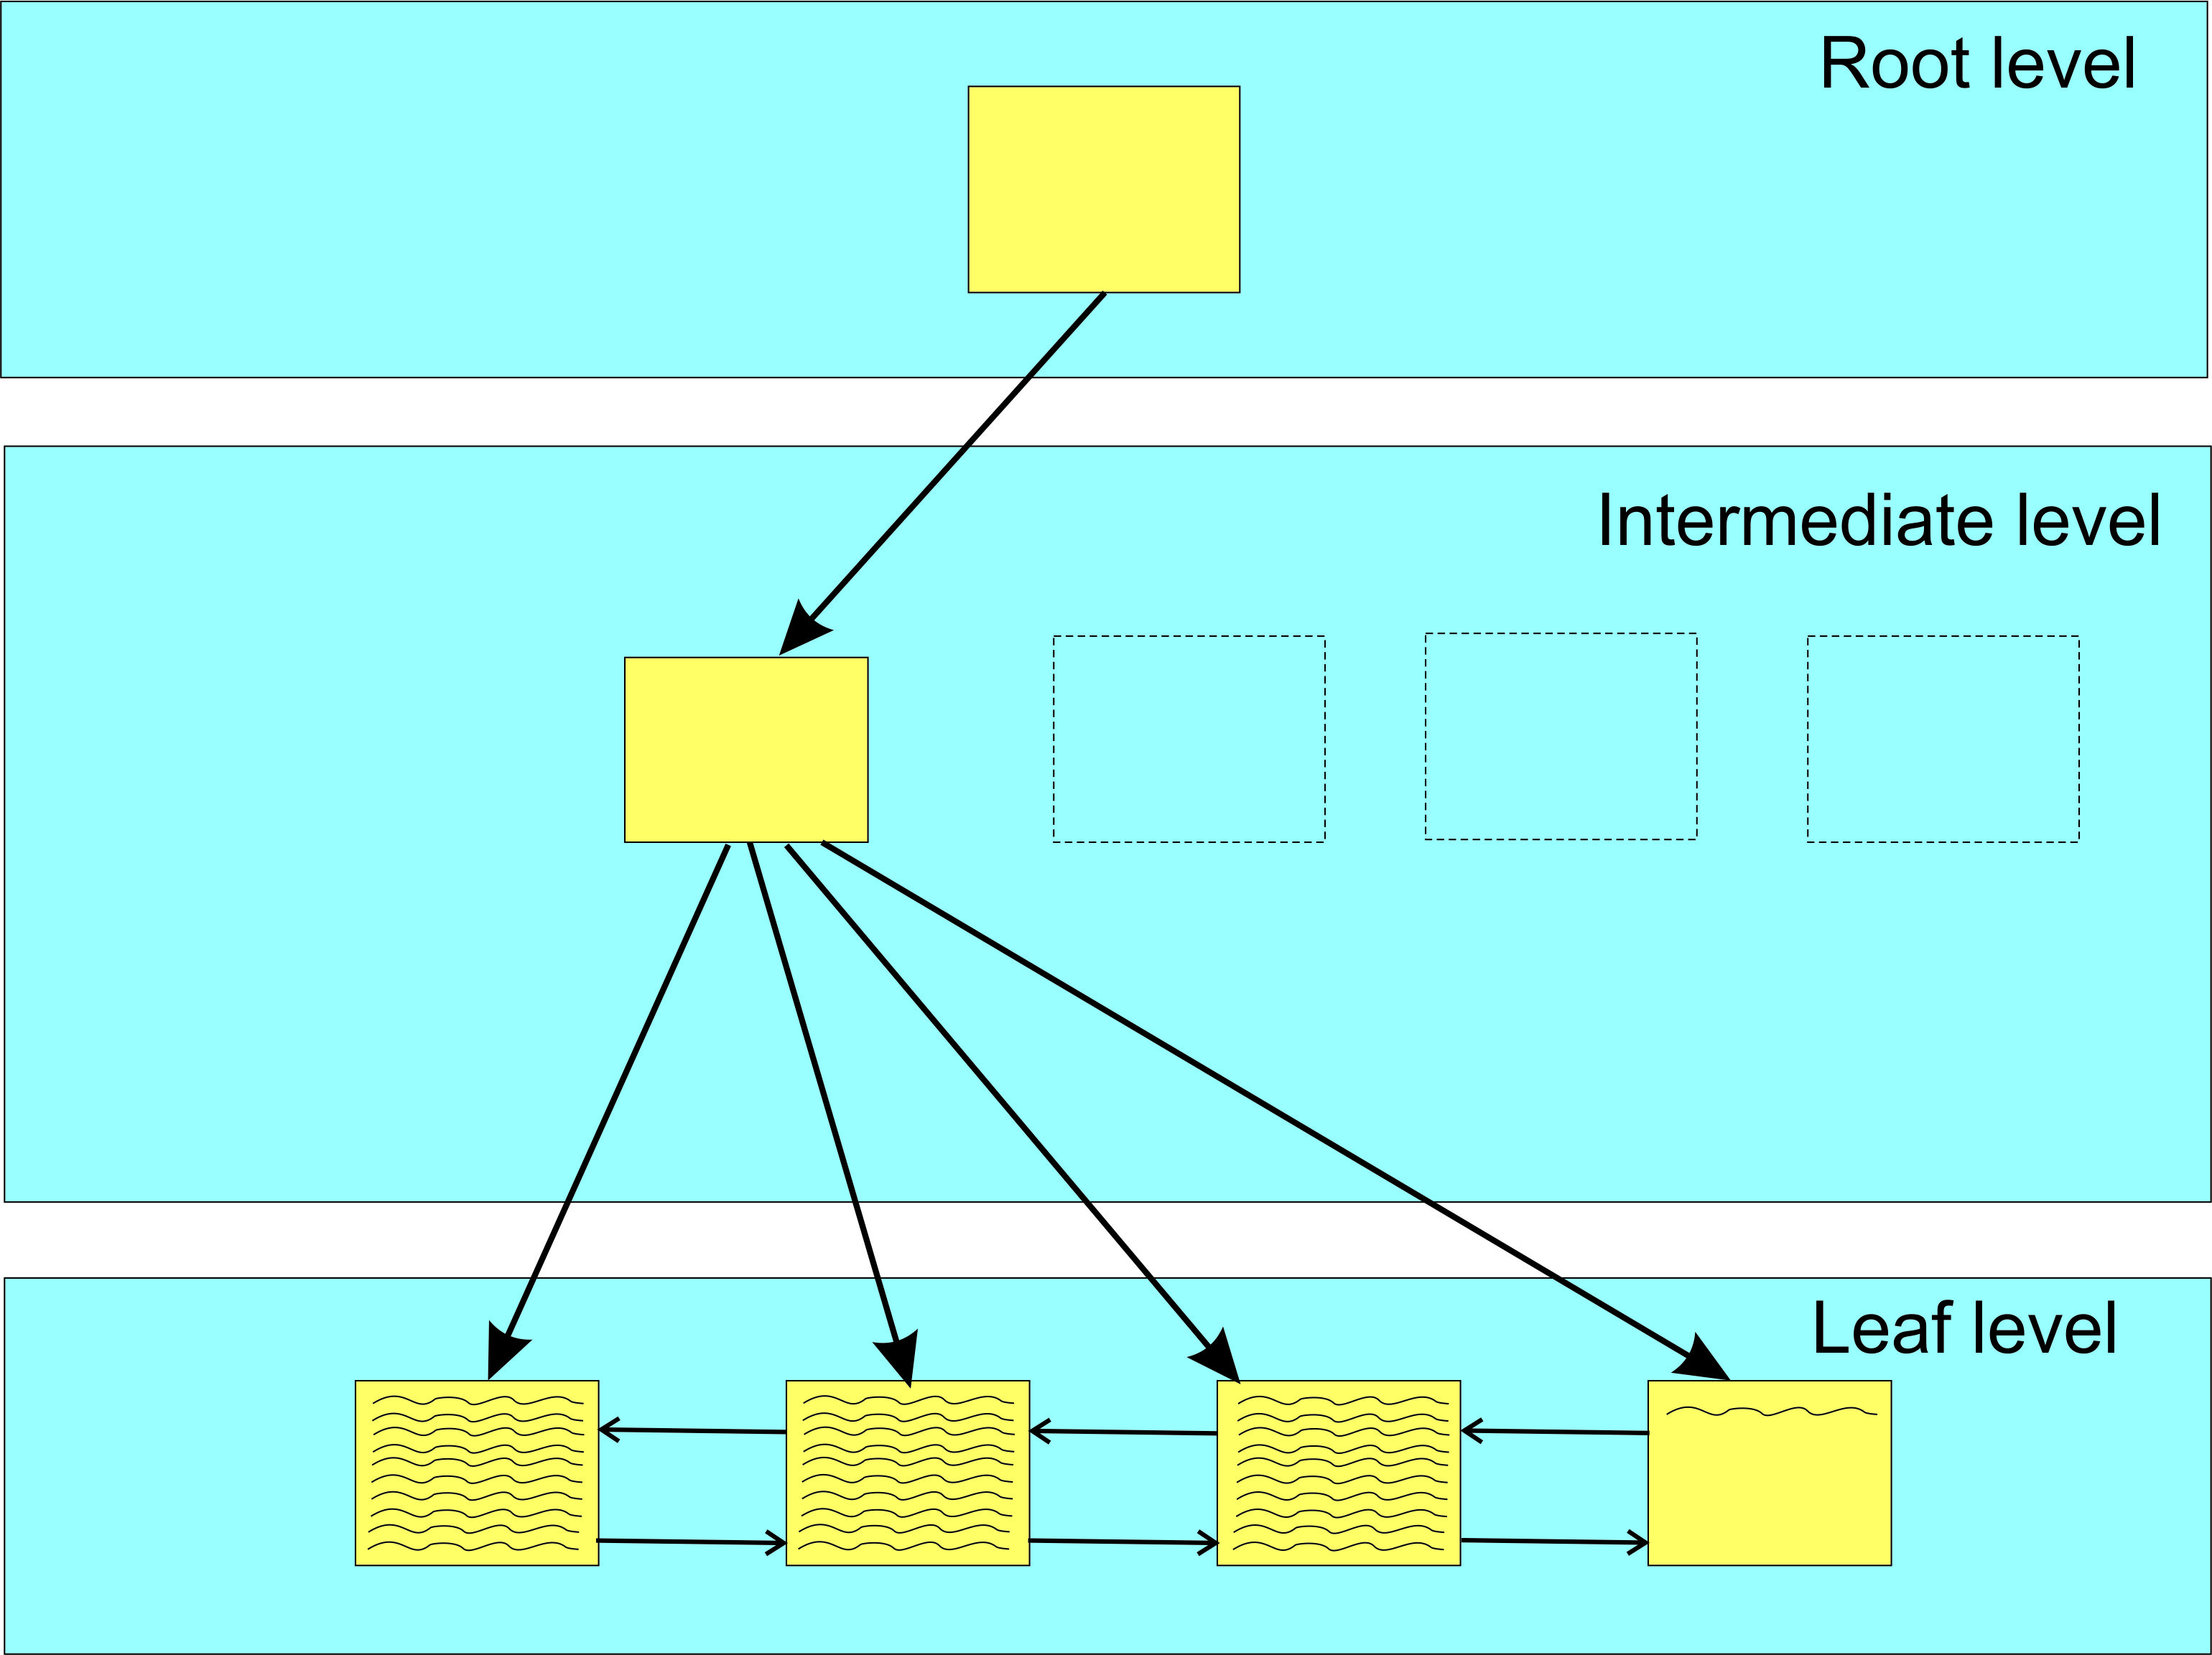
After adding row to index (Identity column)

Slide 14
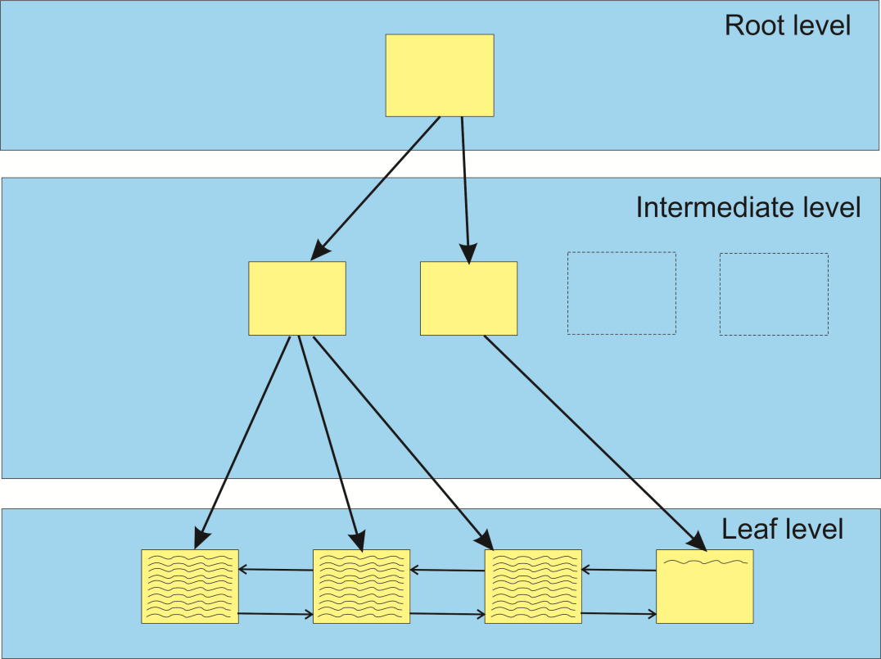
After adding row to index (Identity column, Inter. Node expansion)

Slide 15
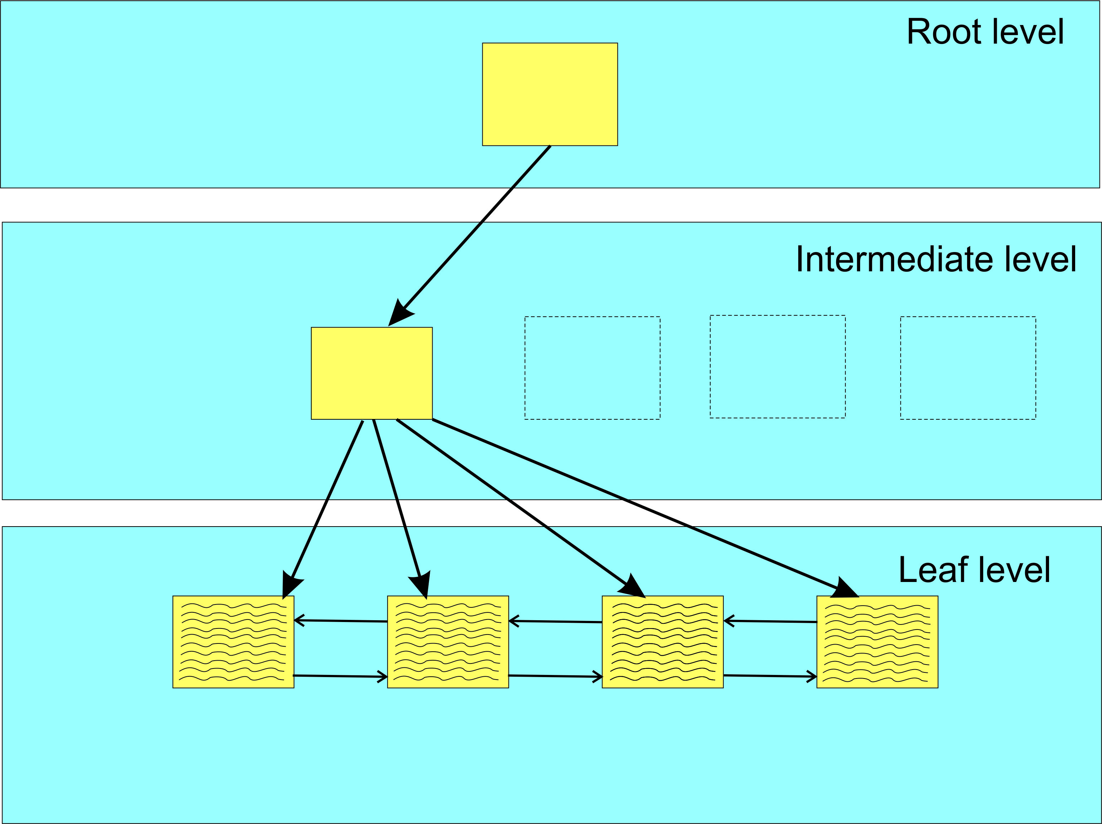
Bad Page Split Example (before row insert, rows aligned with extent)

Slide 16
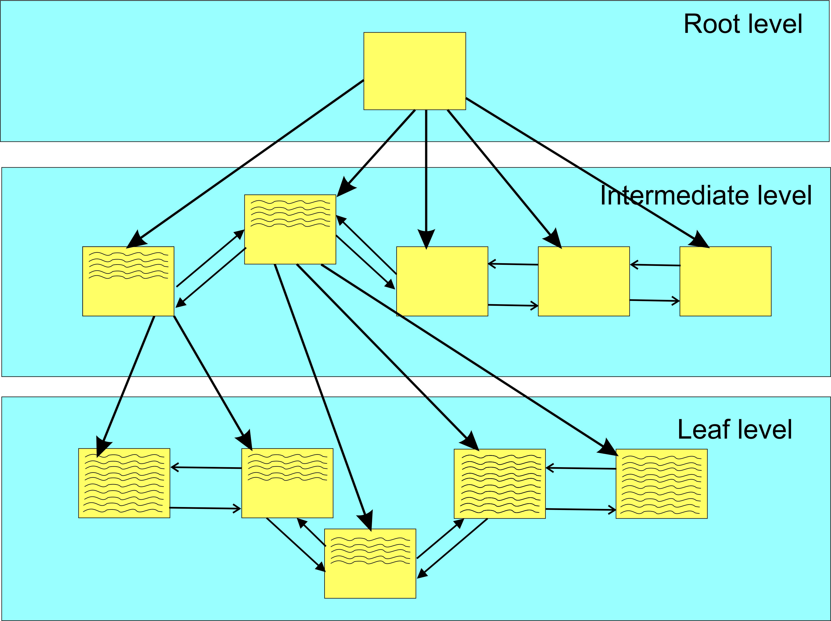
Bad Page Split Example (after row insert, rows not aligned with extent)
All the data moved is
logged in transaction log
Bad Page Split
Bad Page Split

Slide 17
Background
For last 3+ years I have really been diving into indexes and their effect on performance.
But have never really understood how to determine the correct fill factor for an index.
Some guidance
Just no definitive guidance!
What to do????

Slide 18
Background
At SQL Saturday 830 (Colorado Spring, April 2019), I attended two sessions by Jeff Moden titled “Black Arts” Index Maintenance: How the “Best Practice” Methods are Silently Killing Performance.
Both sessions were outstanding!
Can be downloaded from https://www.sqlsaturday.com/830/Sessions/Schedule.aspx

Slide 19
Background
At SQL Saturday 830 (Colorado Spring, April 2019) I attended two session by Jeff Moden titled “Black Arts” Index Maintenance: How the “Best Practice” Methods are Silently Killing Performance.
Both session were outstanding!
Can be downloaded from https://www.sqlsaturday.com/830/Sessions/Schedule.aspx
A Reader’s Digest version of his presentations is contrary to the popular concept to reorganize at 10 % and rebuild indexes at 30%.

Slide 20
Background
At SQL Saturday 830 (Colorado Spring, April 2019) I attended two session by Jeff Moden titled “Black Arts” Index Maintenance: How the “Best Practice” Methods are Silently Killing Performance..
Both session were outstanding!
Can be downloaded from https://www.sqlsaturday.com/830/Sessions/Schedule.aspx
A Reader’s Digest version of his presentations is contrary to the popular concept to reorganize at 10 % and rebuild indexes at 30%.
He showed (in the 2 presentations) that page splits caused tremendous performance degradations and that you should probably rebuild indexes at 1% fragmentation.

Slide 21
Background (cont’d)
On the flight back home I got to thinking about everything he said and how fill factor also “factors” into index performance and maintenance.

Slide 22
Background (cont’d)
On the flight back home I got to thinking about everything he said and how fill factor also “factors” into index performance and maintenance.
It got me to thinking about a brute force optimization technique I implemented way back when I worked at the Air Force Rocket Propulsion Laboratory (yes, I was once a rocket scientist and still a geek!).

Slide 23
Background (cont’d)
On the flight back home I got to thinking about everything he said and how fill factor also “factors” into index performance and maintenance.
It got me to thinking about a brute force optimization technique I implemented way back when I worked at the Air Force Rocket Propulsion Laboratory (yes, I was once a rocket scientist and still a geek!).
It was a technique that involved tweaking various parameters (plus and minus percentages) and trying to discover the best tweaks for an “optimum” solution.

Slide 24
Background (cont’d)
On the flight back home I got to thinking about everything he said and how fill factor also “factors” into index performance and maintenance.
It got me to thinking about a brute force optimization technique I implemented way back when I worked at the Air Force Rocket Propulsion Laboratory (yes, I was once a rocket scientist and still a geek!).
It was a technique that involved tweaking various parameters (plus and minus percentages) and trying to discover the best tweaks for an “optimum” solution.
It was not always perfect as in a multi-dimensional scenario there are valleys that the solution could drill down on, but it did offer “near” optimum solutions that let us explore options.

Slide 25
Approach

Slide 26
Approach
Take a technique similar to Ola Hallengren’s defrag script and modify accordingly.
His script reorganizes at 10% fragmentation and rebuilds at 30% fragmentation.
I was already using his script with no Reorganize and Rebuilds at 10%.

Slide 27
Approach
Take a technique similar to Ola Hallengren’s defrag script and modify accordingly.
His script reorganizes at 10% fragmentation and rebuilds at 30% fragmentation.
I was already using his script with no Reorganize and Rebuilds at 10%.
Need to track performance (fragmentation*) by fill factor for each index (heaps not counted).
Need a table to contain the parametrics involved with the whole rebuild process for each rebuild (tweaking fill factor as needed).
* After 18 months I’m still looking for a better performance parameter that includes bad page splits.

Slide 28
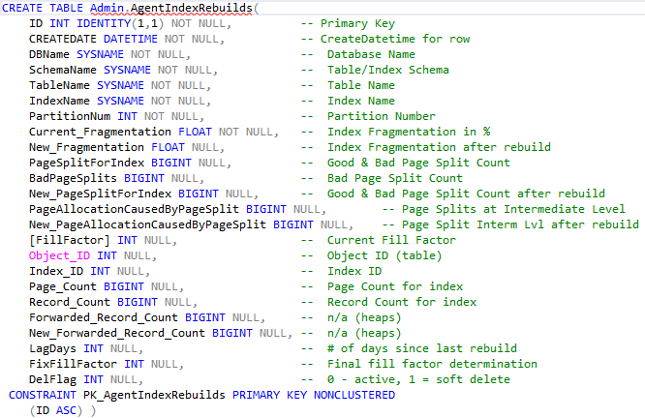
Admin.AgentIndexRebuilds

Slide 29
Approach
Take a technique similar to Ola Hallengren’s defrag script and modify accordingly.
His script reorganizes at 10% fragmentation and rebuilds at 30% fragmentation.
I was already using his script with no Reorganize and Rebuilds at 10%.
Need to track performance (fragmentation) by fill factor for each index (heaps not counted).
Need a table to contain the parametrics involved with the whole rebuild process for each rebuild (tweaking fill factor as needed).
GET TOP 20 indexes with worse fragmentation/bad page splits.

Slide 30
Approach
From Ola’s defrag script we can get average fragmentation in percent.
sys.dm_db_index_physical_stats
Yields average_fragmentation in percent, page_count, row_count.
sys.dm_db_index_operational_stats
Yields Leaf_Allocation_Count, NonLeaf_Allocation_Count.

Slide 31
Approach
From Ola’s defrag script we can get average fragmentation in percent.
sys.dm_db-index_physical_stats
Yields average_fragmentation in percent, page_count, row_count.
sys.dm_db_index_operational_stats
Yields Leaf_Allocation_Count, NonLeaf_Allocation_Count.
Extended event (track bad page splits)
https://www.sqlskills.com/blogs/jonathan/tracking-problematic-pages-splits-in-sql-server-2012-extended-events-no-really-this-time/

Slide 32
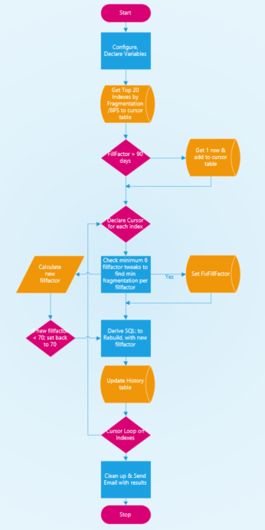
Approach

Slide 33
FillFactorIndexSetup.sql (Sets up history table and extended event). https://github.com/MByrdTX/SQL-Server-Fill-Factor-Determination

Slide 34
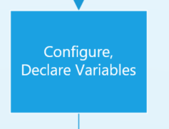
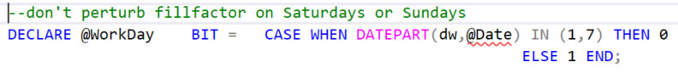
Approach

Slide 35
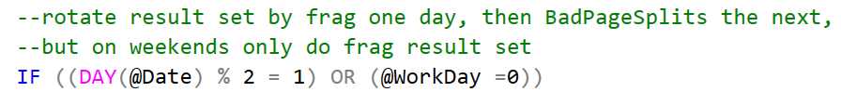
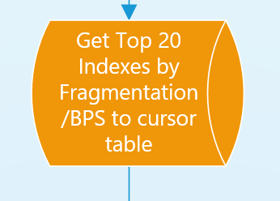
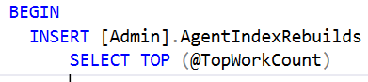
Approach

Slide 36
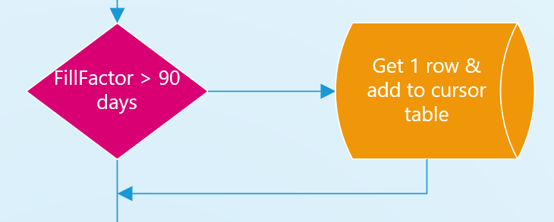
Approach
Go back and find oldest (> 90 days) fixed
fill factor in history table and insert new
row in cursor table.

Slide 37
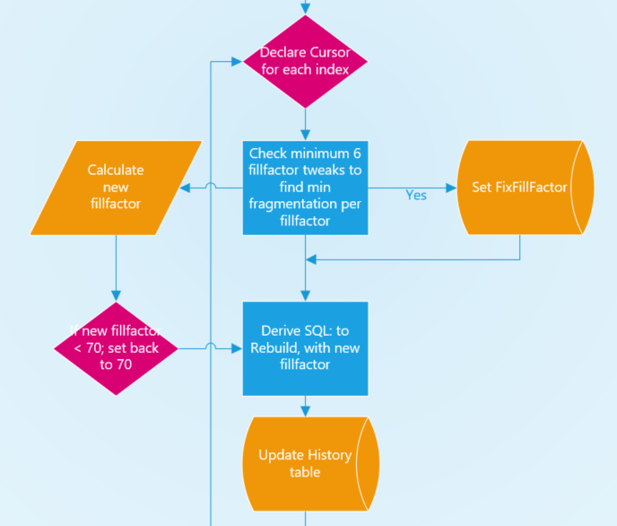
Approach
On weekdays use new fillfactor;
on weekends rebuild with old fillfactor.

Slide 38
SQLAgentScriptRebuildIndexes.sql (SQL Agent Job, runs once/day). https://github.com/MByrdTX/SQL-Server-Fill-Factor-Determination

Slide 39
Thought process for fixing fill factor
Collect at least 6 data sets (tweaks) for each index.
Find smallest fragmentation.
Not last 2 latest data sets.
If last 2 data sets have lowest frag value, continue tweaking.
Identify fill factor for the smallest fragmentation and set FixFillFactor.
Script then checks FixFillFactor and stops tweaking when not null (until 90 day mark comes around).

Slide 40
Approach: Fixing the Fill Factor

Slide 41
Approach: Fixing the Fill Factor
IndexName | Frag | BadPageSplits | FillFactor | LagDays | Redo | Action | Fix | Duration | DelFlag
IDX_File_AdvanceFileNotification_AdvanceFileNotificationID | 1.298956898 | 5 | 100 | NULL | 1 | F | 94 | 13 | 1
IDX_File_AdvanceFileNotification_AdvanceFileNotificationID | 3.299091268 | 172 | 98 | 1 | 0 | F | 94 | 12 | 1
IDX_File_AdvanceFileNotification_AdvanceFileNotificationID | 0.731948566 | 36 | 96 | 1 | 0 | F | 94 | 15 | 1
IDX_File_AdvanceFileNotification_AdvanceFileNotificationID | 0.466109924 | 32 | 94 | 1 | 0 | F | 94 | 11 | 1
IDX_File_AdvanceFileNotification_AdvanceFileNotificationID | 1.225259189 | 2 | 93 | 24 | 0 | F | 94 | 13 | 1
IDX_File_AdvanceFileNotification_AdvanceFileNotificationID | 1.31945735 | 0 | 92 | 21 | 0 | F | 94 | 15 | 1
IDX_File_AdvanceFileNotification_AdvanceFileNotificationID | 1.209234152 | 3 | 94 | 22 | 0 | F | 94 | 13 | 0
IndexName | Frag | BadPageSplits | FillFactor | LagDays | Redo | Action | Fix | Duration | DelFlag
IX_FileSection_OutputTemplateAttribute | 3.032351793 | 5500 | 100 | NULL | 1 | F | 88 | 551 | 1
IX_FileSection_OutputTemplateAttribute | 4.073895618 | 9499 | 98 | 1 | 0 | F | 88 | 400 | 1
IX_FileSection_OutputTemplateAttribute | 3.075076184 | 6126 | 96 | 1 | 0 | F | 88 | 432 | 1
IX_FileSection_OutputTemplateAttribute | 2.441710901 | 2767 | 94 | 4 | 0 | F | 88 | 358 | 1
IX_FileSection_OutputTemplateAttribute | 2.056251983 | 4247 | 92 | 1 | 0 | F | 88 | 374 | 1
IX_FileSection_OutputTemplateAttribute | 1.772292167 | 3786 | 90 | 1 | 0 | F | 88 | 615 | 1
IX_FileSection_OutputTemplateAttribute | 1.708401194 | 3693 | 88 | 1 | 0 | F | 88 | 414 | 1
IX_FileSection_OutputTemplateAttribute | 1.75753109 | 514 | 86 | 3 | 0 | F | 88 | 366 | 1
IX_FileSection_OutputTemplateAttribute | 2.179400437 | 2163 | 84 | 2 | 0 | F | 88 | 374 | 1
IX_FileSection_OutputTemplateAttribute | 2.148127628 | 2184 | 88 | 2 | 0 | F | 88 | 478 | 0

Slide 42
Nightly Email Report - 1

Slide 43
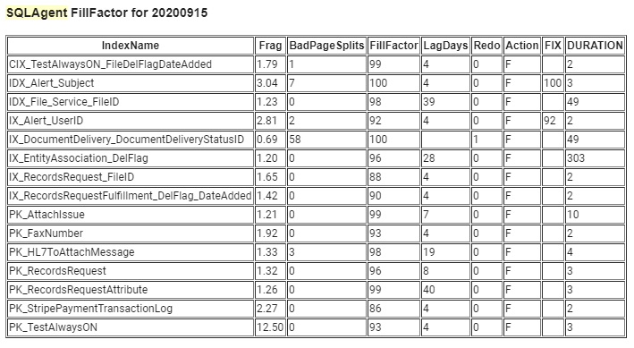
Nightly Email Report - 2

Slide 44
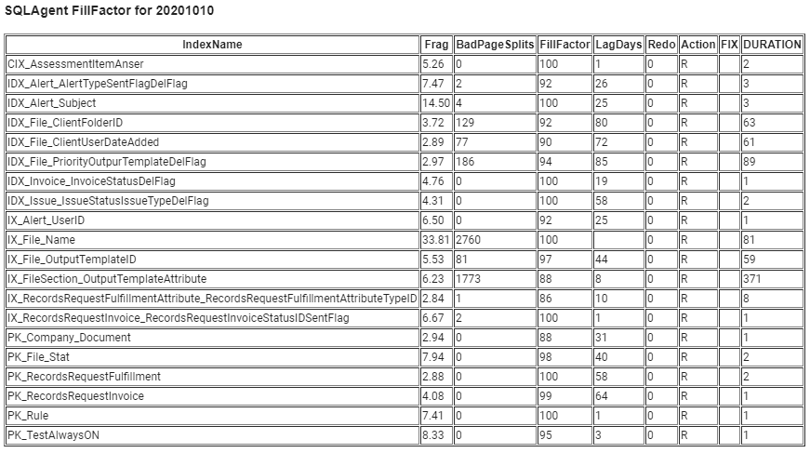
Nightly Email Report - Weekend

Slide 45
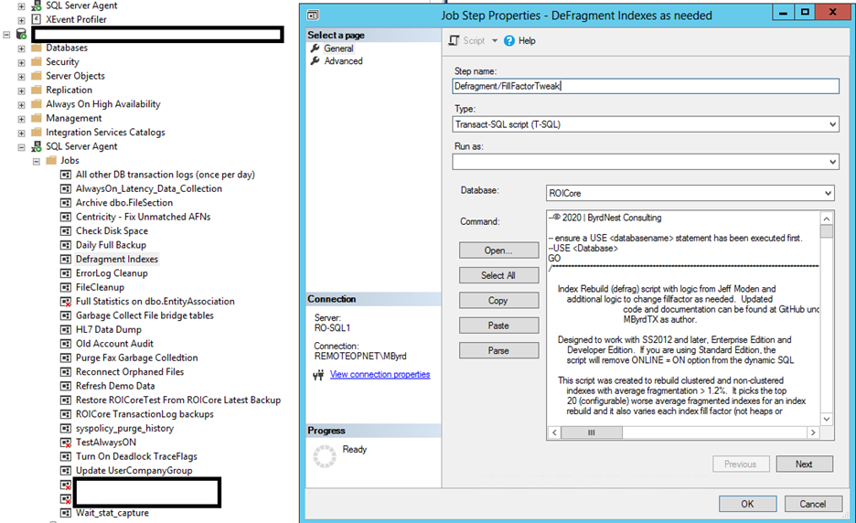
SQL Agent Job:

Slide 46
SQL Agent Job:

Slide 47
Analysis - 1
Initially set up SQL Agent job (nightly) to collect data and vary fill-factor from 100 (default) down.
Schedule during low database activity.
As data was collected, added new columns to history table and revised logic to determine and/or fix fill factor for each index code identified (as needing tweaking).
Eventually saw need to re-tweak fill factors after period of time (90 days) to allow for new pattern in data access (app changes, data skew).

Slide 48
Analysis - 2
Ran data collection on very active client OLTP database.
225gb real data (not including sprocs, views, etc.)
249 tables
694 indexes
24x7 environment
In first 90 day period only 164 indexes (clustered & non-clustered) recorded and fill factor “tweaked”.
Saw no real performance hits when running fill factor script.

Slide 49
Indexes encountered
Clustered Index
Based on sequential increase (Identity column).
Based on Parent Table plus primary key (Identity column).
FileAttribute table {FileID,FileAttributeID; PK = FileAttributeID}
Non-Clustered Index.
Usually based on non PK column.

Slide 50
Analysis - 3

Slide 51
Analysis - 4

Slide 52
Analysis - 5

Slide 53
Analysis - 6
Unfortunately did not have good benchmarks for database performance, but…….

Slide 54
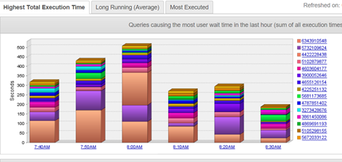
Analysis: DPA screen shot from late Feb 2019 (Typical server performance during the day)

Slide 55
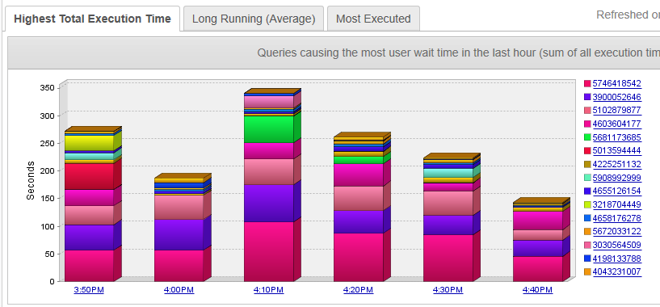
Analysis: DPA screen shot from late June 2019 (Typical server performance during the day)

Slide 56
Analysis: Performance
Today, still have average database wait times totalling around 300 seconds/10 minute period.
The database has grown.
Business has evolved into different paths (data access, data skew).
There are spikes > 300 seconds, but average remains ~300 seconds.

Slide 57
Analysis: Performance
Overall decrease in database wait times of about 25 - 30%.
{Yes, I know different times, but screen shots are indicative of performance through the day.}

Slide 58
Analysis: Performance
Overall decrease in database wait times of about 25 - 30%.
With decreased fragmentation, there are less page splits to wade through for IO range searches.

Slide 59
Analysis: Performance
Overall decrease in database wait times of about 25 - 30%.
With decreased fragmentation, there are less page splits to wade through for IO range searches.
With improved fill factor, there are less bad page splits.
The cost of a page split can be significant.
First the new page has to be identified, pointers made to it, data movement from the old page to the new page, and finally all of this is logged.

Slide 60
Requirements
SQL Server 2012 and above.
Enterprise version recommended (ONLINE option).
Standard Edition can be used, but have to be wary of schema locks.
Data compression = ROW recommended.
Already have in Enterprise.
Have in SS2016SP2 and later for Standard Edition.

Slide 61
Short-comings!
Varying business loads during each business day can/will affect the fragmentation value.
This will affect the FixFillFactor determination
Code added to only rebuild indexes on weekends (not count for tweaking fillfactor).
Really would like to find a mathematical relationship between fragmentation, bad page splits, and index page count for a better performance parameter (instead of just current_fragmentation).

Slide 62
Wish List
Add code for multiple databases on same server.
May want to have separate database for history table.

Slide 63
Wish List
Add code for multiple databases on same server.
May want to have separate database for history table.
Really would like to find mathematical relationship between fragmentation, bad page splits, and index record count to use as performance parameter.
A colleague of mine has been using PowerBI to review the history table, but neither of us has found a good correlation using bad page splits.

Slide 64
Wish List
Add code for multiple databases on same server.
May want to have separate database for history table.
Really would like to find mathematical relationship between fragmentation, bad page splits, and index record count to use as performance parameter.
Current fill factor approach not implemented for partitioned indexes (it would really be nice to have fill factor per partition; that way the old data partitions could be set to 100% and the active partitions set as needed {this should be placed on Microsoft’s wish list ☺} ).

Slide 65
Wish List (cont’d)
Build in additional features as suggested by the community.

Slide 66
Wish List (cont’d)
Build in additional features as suggested by the community.
More testing on performance improvements with firm numbers.

Slide 67
Wish List (cont’d)
Build in additional features as suggested by the community.
More testing on performance improvements with firm numbers.
Need better way of monitoring Admin.AgentIndexRebuilds. – both manually and also self-reviewing.
Any volunteers out there to implement a dash board????

Slide 68
Wish List (cont’d)
Are nightly rebuilds necessary?
Jeff Moden/Brent Ozar don’t think so.
IMHO yes to establish fill factor (current script defrags on weekends).
I’ve seen 5 minute to 3 hour run times for this script, but little effect on production query performance.

Slide 69
Ongoing Work
Still monitoring and analyzing!
Script has been stable last 2+ months!
May need to limit number of large tables for night evaluation.
Script had run from 2 minutes to almost 3 hours.

Slide 70
Conclusions
This whole idea started as a proof of concept.
Offers potential performance benefits.
Does demonstrate that effective automatic determination of Fill Factor IS possible!
Current code in production for 20 months.

Slide 71
Question to you?
This concept has been copyrighted with the idea that it belongs to the SQL Server Community.
I look forward to constructive critique and suggests for improvements from the SQL Server Community.

Slide 72
Finally
With the 25% potential drop in database wait times, why are you not using the concept?
Scripts available at
https://github.com/MByrdTX/SQL-Server-Fill-Factor-Determination

Slide 73
Mike Byrd
@ByrdNest_TX
mbyrd@ByrdNest-TX.com

